Slide 1
Hypothesis Testing
Decision making under uncertainty

Slide 2
Statistical Inference
Confidence Intervals
Hypothesis
Testing

Slide 3
Problem Name: Emergency Service Response Times
Application: Hypothesis Testing Concerning a Population Mean
Problem Description:
Operating in a multiple hospital system with approximately 40 mobile medical units, the service goal is to be able to respond to medical emergencies with a mean time of 12 minutes or less.
The director of medical services wants to formulate a hypothesis testing procedure that could use a sample of emergency response times to determine whether or not the service is meeting the 12 minute or less response time goal. We are required to test the claim that the service is meeting its 12 minute mean response time goal.

Slide 4

States of Nature:
Innocent
Guilty
Decision:
Freedom
Jail
Correct decision
( true negative )
Incorrect Decision
( false negative )
Type II Error
Incorrect decision
( false positive )
Correct Decision
( true positive )
Type I Error
Power

Slide 5
Testing the Claim that the emergency service is meeting its 12 minute mean response time goal.
Let
μ = mean response time for the population of medical emergency requests.
Hypotheses Conclusion and Action
Ho: μ < 12 Emergency service meeting the response goal;
no action necessary.
Ha: μ > 12 Emergency service not meeting
the response goal; take appropriate follow-up action.

Slide 6
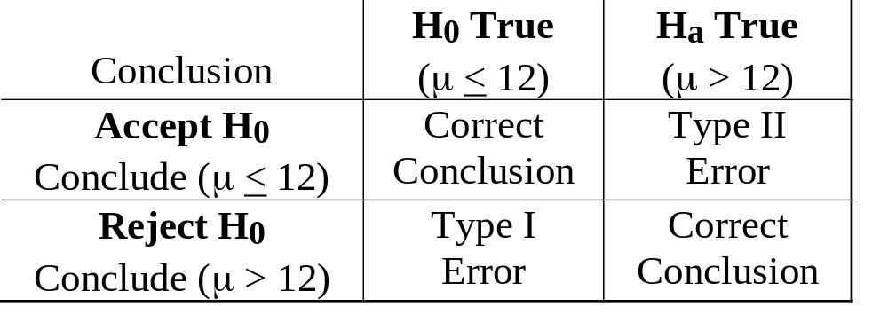
Errors Involved in Hypothesis Testing
Type I Error: Reject Ho when it is true. (Claiming that the medical emergency service is not meeting the response goal when in fact it is.)
Type II Error: Accept Ho when it is false. (Claiming that the medical emergency service is meeting the response goal when in fact it is not.)

Slide 7
Equivalent Descriptions Of A Statistically Significant Result.
Reject the null hypothesis.
Accept the alternative hypothesis.
There is strong evidence to doubt the null hypothesis.
The chance of the result being spurious is small, for example less than 5%.
Observed result is not compatible with the null hypothesis.
Sampling variation is not sufficient to explain the observed result.
Result unlikely to be due to chance alone.
Caveat: We never actually “accept” the null hypothesis

Slide 8
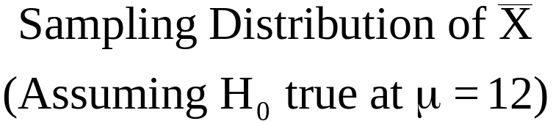
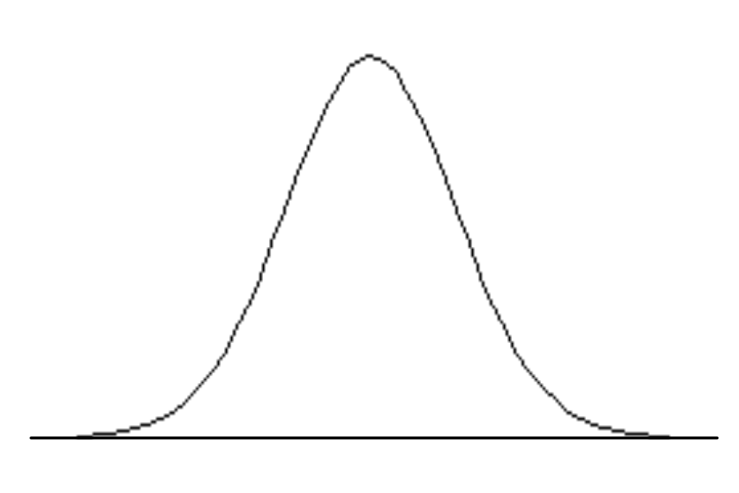
Level of Significance
α = Prob(Type I Error) = 0.05
Specified by the
designer of the test
Reject Null Hypothesis
Fail to Reject Null Hypothesis
5%
μ = 12

Slide 9
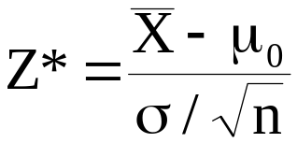
Using the Standardised Test Statistic
where μ₀ = hypothesised value of μ in H₀.
Reject Null Hypothesis
Fail to Reject Null Hypothesis
5%
0
1.645
For α = 0.05, i.e., type I error of 5%, we’d reject H₀ if Z* > 1.645

Slide 10
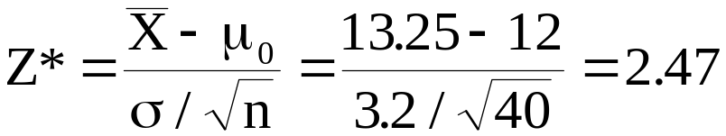
Sample Data
n = 40
X= 13.25 minutes
s = 3.2 minutes (Sample standard deviation can be used to estimate the population standard deviation σ.)
Reject the
null hypothesis:
Ho: μ < 12
1.645

Slide 11
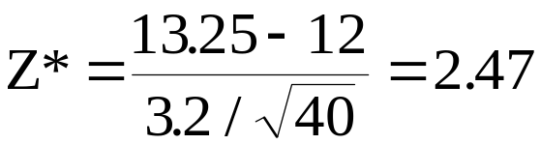
Using the p-value to Test the Hypothesis
The p-value is the probability, when the null hypothesis is true. of obtaining a sample result that is at least as unlikely as the observed result.
Sample results: Xbar = 13.25 minutes
Area in upper tail equals 0.0068, or equivalent to 0.68% which is very small indeed.
0 2.47

Slide 12

A Summary of Forms for Null and Alternative Hypotheses about a Population Mean
The equality part of the hypotheses always appears in the null hypothesis.
In general, a hypothesis test about the value of a population mean μ must take one of the following three forms (where μ₀ is the hypothesized value of the population mean).
H₀: μ > μ₀ H₀: μ < μ₀ H₀: μ = μ₀
H_{a}: μ < μ₀ H_{a}: μ > μ₀ H_{a}: μ μ₀

Slide 13
Statistical Significance versus Practical Significance
The hypotheses tests described in this course address issues of statistical significance.
We try to determine whether the observations are so unlikely that we are lead to believe that differences are due to factors other than chance sample fluctuations.
Experimental results can sometimes be statistically significant without being practically significant.
A diet causing an average weight loss of 1/2 lb might be statistically significant if the sample size is 10,000, but such a diet would not have practical significance.
Nobody would bother with a diet that resulted in a loss of only 1/2 lb.

Slide 14
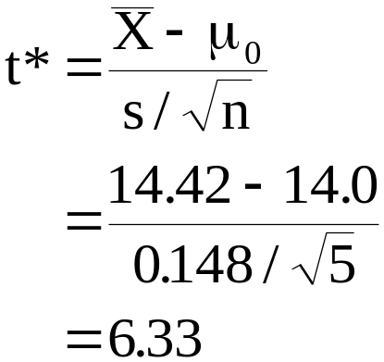
Problem Name: Cigarette Tar Content (Part 1)
Problem Description: Five measurements of the tar content of a certain type of cigarette yielded 14.5, 14.2, 14.4, 14.4, and 14.6 (milligrams per cigarette). Show that the difference between the mean of this sample, 14.42 mg/cg, and the average tar content claimed by the cigarette manufacturer, μ_{o} = 14.0, is significant at the 5% significance level (α = 0.05).
t distribution on 9
degrees of freedom
-2.776
+2.776

Slide 15
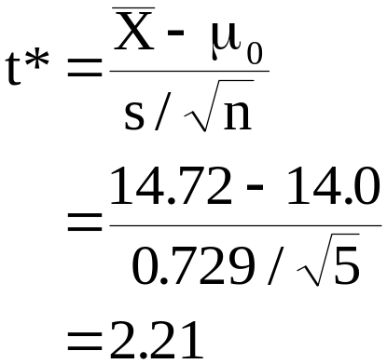
Problem Name: Cigarette Tar Content (Part 2)
Problem Description: Suppose that in the preceding exercise the first measurement is recorded incorrectly as 16.0 instead of 14.5. Show now that the difference between the mean of the sample, and the average tar content claimed by the cigarette manufacturer, μ_{o} = 14.0, is not statistically significant at α = 0.05.
Explain the apparent paradox that even though the difference between and μ has increased, it is no longer significant.
t distribution on 9
degrees of freedom
-2.776
+2.776

Slide 16
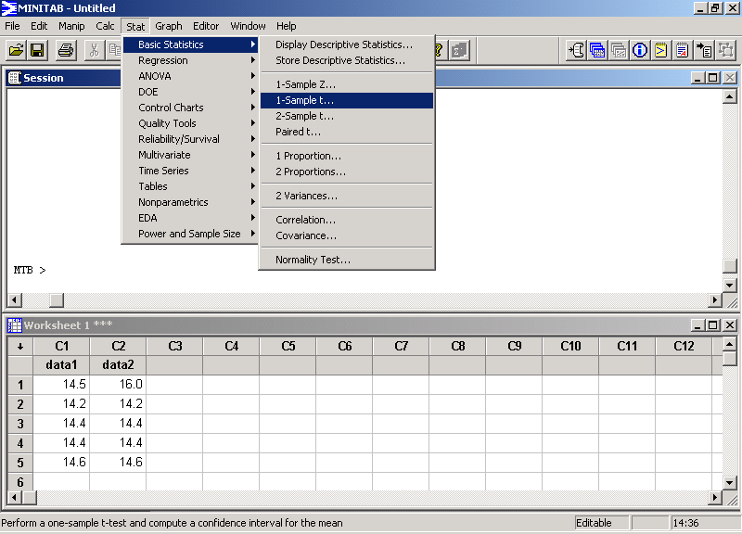

Slide 17
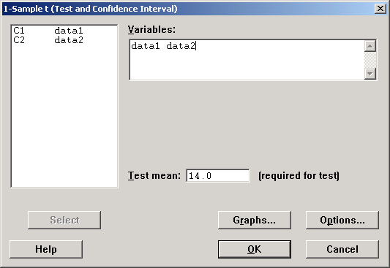
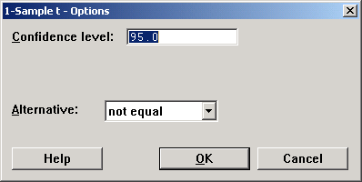
Clicking Options we get the following dialogue box…

Slide 18
One-Sample T: data1, data2
Test of mu = 14 vs mu not = 14
Variable N Mean StDev SE Mean
data1 5 14.4200 0.1483 0.0663
data2 5 14.720 0.729 0.326
Variable 95.0% CI T P
data1 ( 14.2358, 14.6042) 6.33 0.003
data2 ( 13.814, 15.626) 2.21 0.092
Confidence Interval and Hypothesis Testing
A 95% confidence interval for a sample mean can be used to achieve the exact same objectives as a two-tailed hypothesis test with α = 0.05.
A 90% confidence interval for a sample mean can be used to achieve the exact same objectives as a one-tailed hypothesis test with α = 0.05.

Slide 19
x = c(14.5, 14.2, 14.4, 14.4, 14.6)
y = c(16.0, 14.2, 14.4, 14.4, 14.6)
t.test(x)
t.test(y)
curve(dnorm(x), from = -4, to = 4, ylim = c(0,0.5))
curve(dt(x, df=4), from = -4, to = 4, col = "red", add = TRUE)
curve(dt(x, df=10), from = -4, to = 4, col = "blue", add = TRUE)
curve(dt(x, df=30), from = -4, to = 4, col = "pink", add = TRUE)
t.ratio = function(x, test.value = 0) sqrt(length(x)) * (mean(x) - test.value) / sd(x)
M = 10000
N = 7
set.seed(54321)
X = matrix(rnorm(n = M*N), M, N)
Tratios = apply(X, 1, t.ratio)
rejected = abs(Tratios) > qt(p = 0.975, df = (N-1))
round( 100 * sum( rejected ) / M , 1)

